Slide 1

Real-Time Chat Application: Introduction
This presentation delves into the intricacies of real-time chat applications, exploring key features, architectural design, and technological considerations.

Slide 2
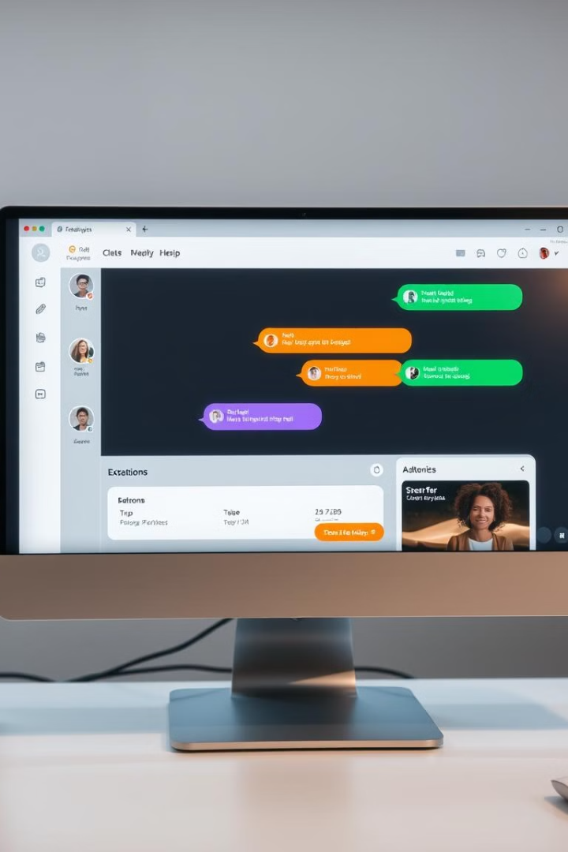
Key Features and Functionalities
1
Real-Time Messaging
2
Group Chat Support
Users can send and receive messages instantly, enabling seamless communication.
Allows multiple users to engage in simultaneous conversations within dedicated chat groups.
3
File Sharing
4
Multimedia Support
Users can exchange files of various formats, including images, documents, and videos.
Enables users to share and view multimedia content, such as images, videos, and audio.

Slide 3
Architectural Design
Client-Side
Server-Side
Database
The client-side consists of the user interface (UI) and the application logic that handles user interactions.
The server-side manages user connections, message routing, and data persistence, ensuring reliable communication.
The database stores user information, chat history, and other relevant data, providing persistent storage for application data.

Slide 4
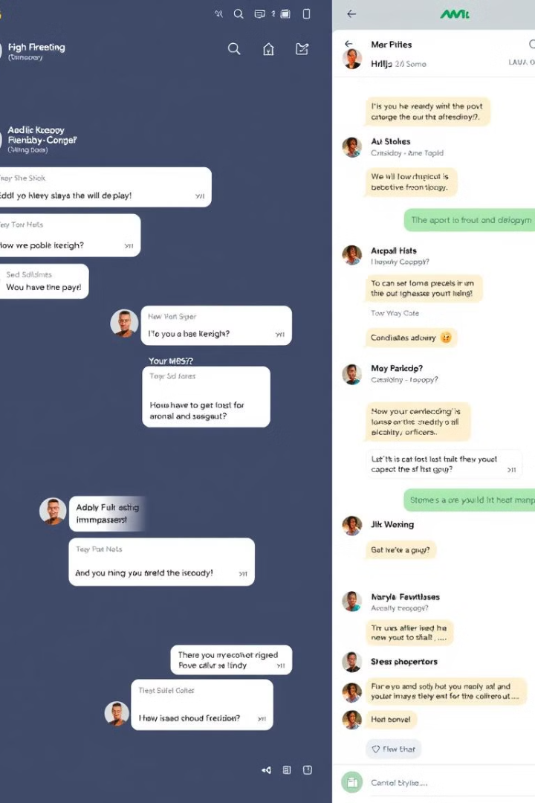



Real-Time Messaging
Message Sending
Users compose and send messages through the client-side application.
Server Processing
The server receives and processes the message, validating and storing it.
Message Delivery
The server delivers the message to the intended recipient in real-time.

Slide 5
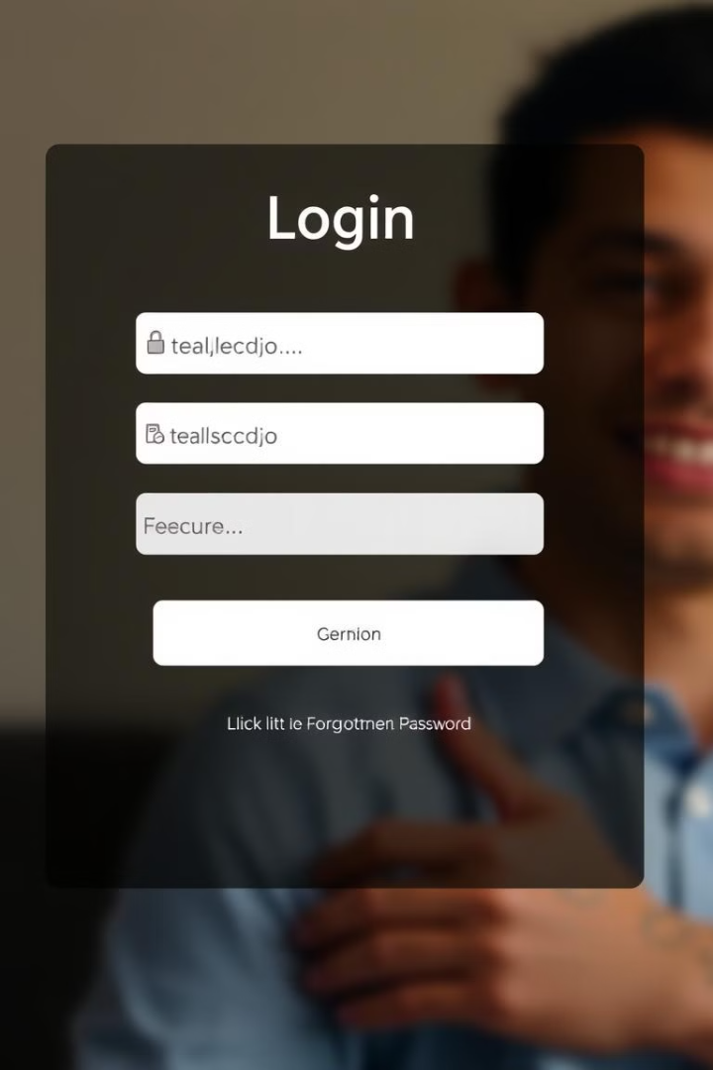
User Authentication and Authorization
Registration
Login
New users create accounts by providing basic information and setting a secure password.
Existing users authenticate with their credentials, enabling access to the chat application.
Authorization
The system verifies user permissions, ensuring access to appropriate features and data.

Slide 6

Presence Indicators and Online Status
Online Status
Indicates whether a user is currently active in the chat application.
Typing Indicator
Signals that a user is currently composing a message.
Last Seen Timestamp
Displays the last time a user was active, providing context for their availability.

Slide 7





File Sharing and Multimedia Support
Image Sharing
Video Sharing
Users can share images directly within the chat application.
Enables users to share videos, offering a more interactive communication experience.
Document Sharing
Audio Sharing
Users can exchange documents, making collaborative work seamless.
Allows users to share audio files, enhancing communication and entertainment.

Slide 8

Scalability and Performance Considerations
Horizontal Scaling
1
Adding more servers to handle increasing user traffic and message volume.
2
Load Balancing
Distributing traffic evenly across multiple servers to optimize performance and avoid bottlenecks.
Caching
3
Storing frequently accessed data in memory to reduce database load and improve response times.

Slide 9

Security and Privacy Measures
1
Encryption
2
Access Control
All messages are encrypted in transit and at rest, protecting user communication from unauthorized access.
Strict access controls limit user access to specific data and functionalities, ensuring privacy and security.
3
Regular Security Audits
Regular security audits and vulnerability assessments identify and address potential security risks.

Slide 10

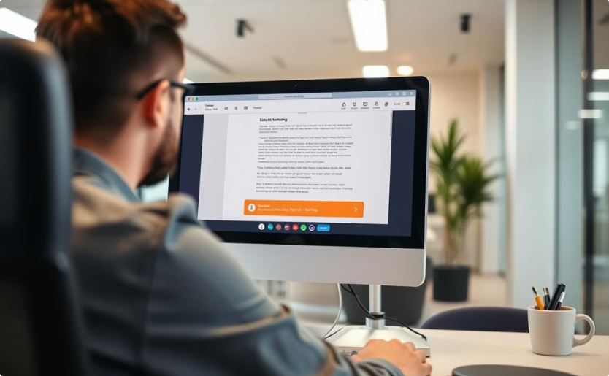
Future Enhancements and Roadmap
Voice and Video Calling
Screen Sharing
Integrating voice and video calling capabilities to enrich communication.
Enabling users to share their screens for presentations, tutorials, or collaborative work.

